Slide 2
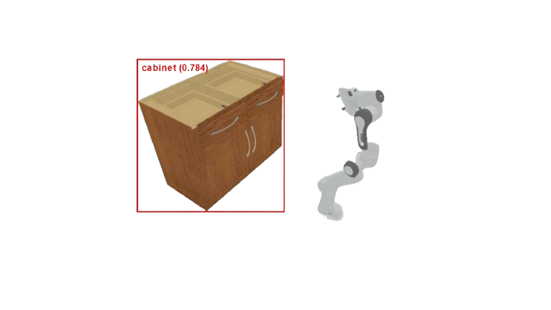
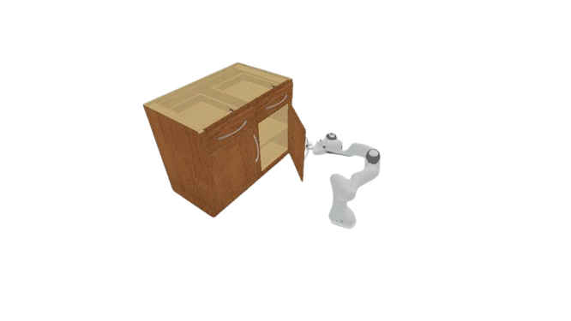

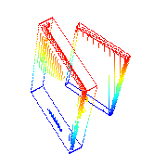
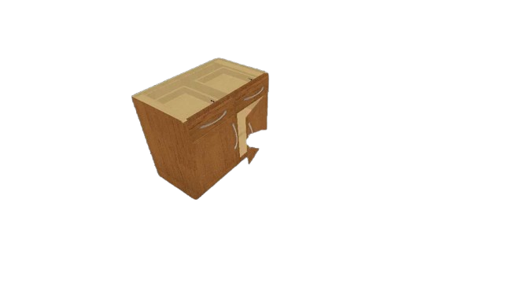
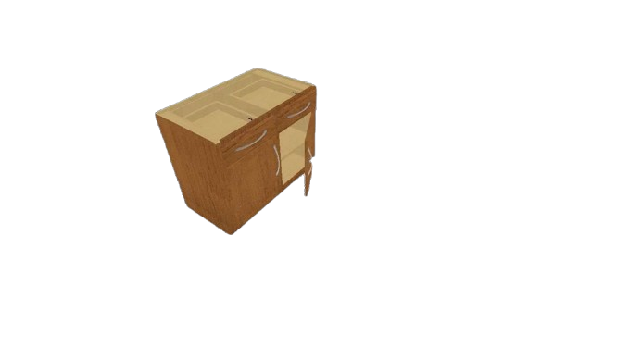
Interactive Perception &
Init-Manipulation Module
Tracking & Segmentation Module
Axis Estimation & Manipulation Module
Initial Observation
First Frame
Manipu
-late
Detector
…
Tracking
RGB-D
Frames
Init
RGB Frames
SAM2
Active Part Point-clouds
Interactive
Perception
Technique
RGB-D
Frames
Previous
Depth Maps
Scene Point Cloud
Frames
Tracking Mask
Frames
…
OBB
Pose Sequence
…
…
&
Current
Axis
Slight Movement
Observation
Object Tracking
Frames
Motion Part
Frames
Explicit
Axis Estimation
…
…

Slide 3

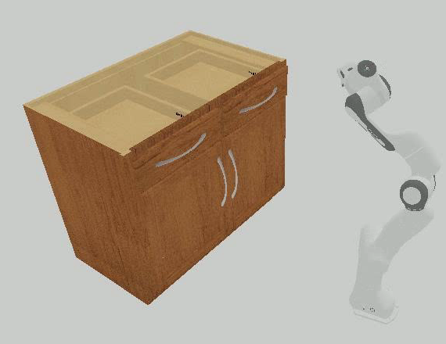
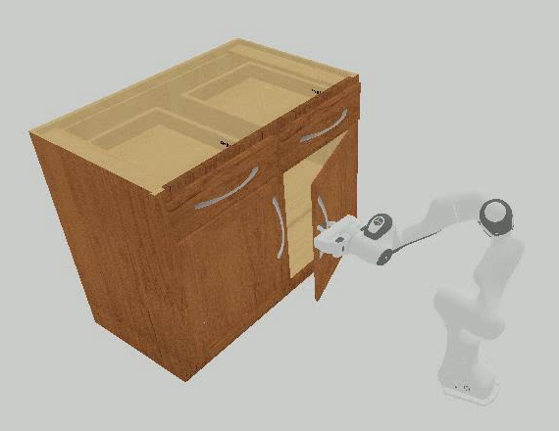
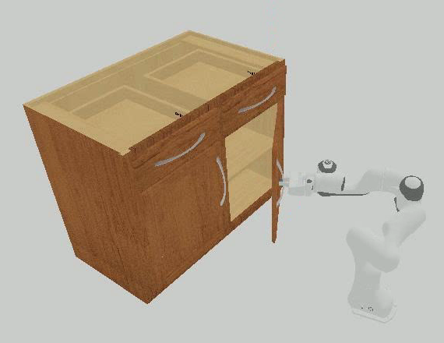
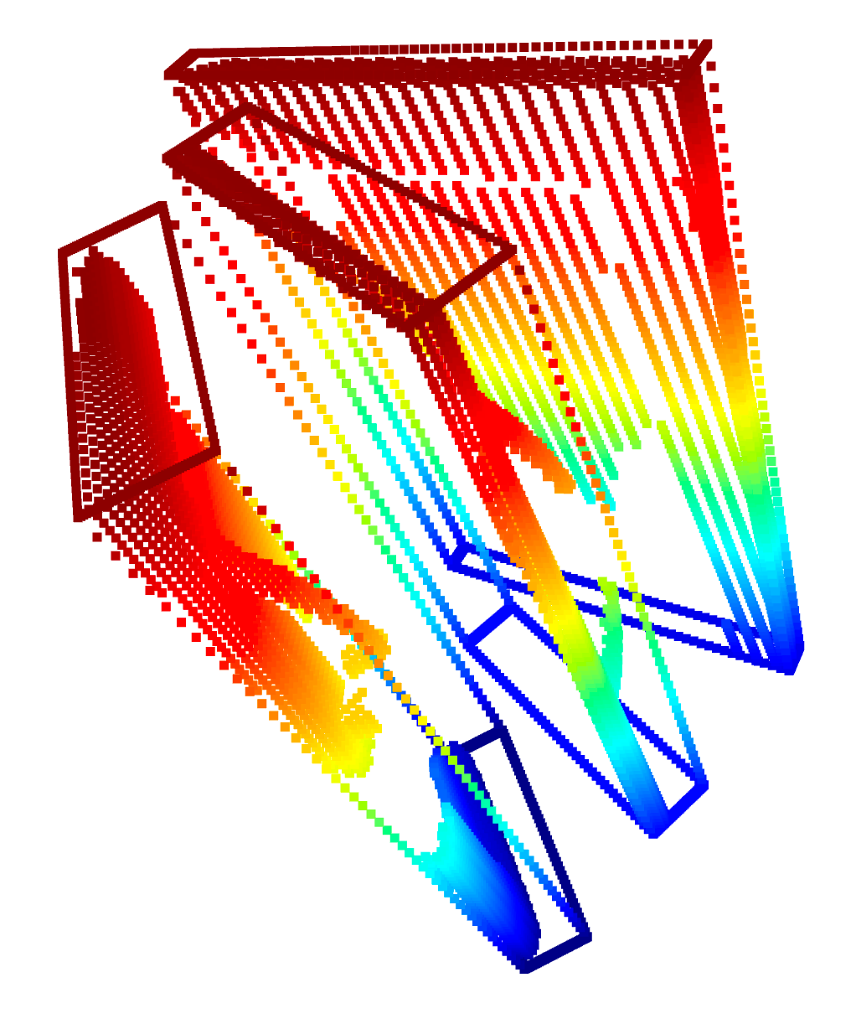
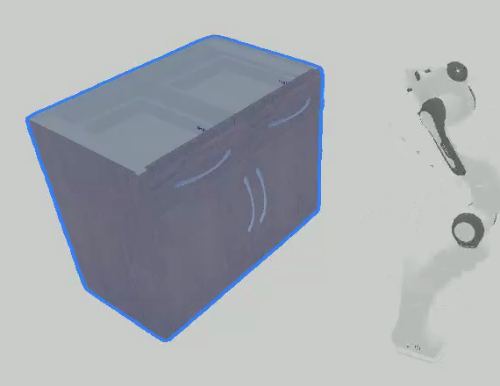
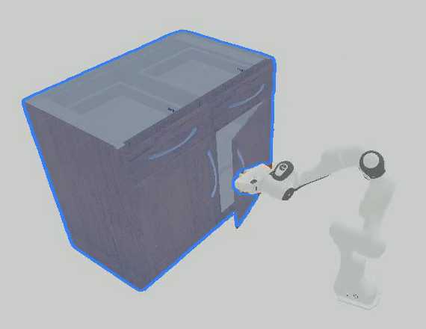
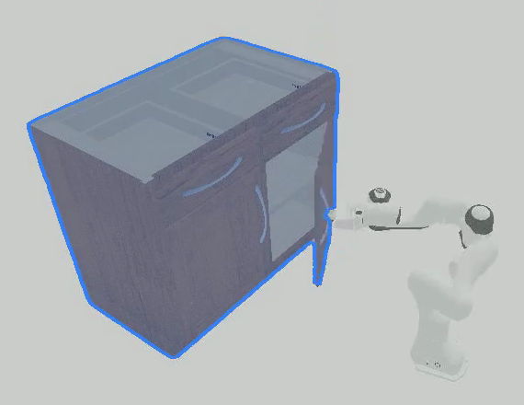
…
OBB
SAM2
…
Explicit Axis Estimation
Online Tracking
Estimated
Axis
Manipulate

